Slide 1
Automation Intelligent
@Power by Soonr.jar

Slide 2
Architecture for Soonr.jar
Web server
php
Ask for new task
telnet
Internal
network
soonr.jar
Return task
php+
mysql
real-time control
HeartBeat Control
call
telnet
Heartbeat
“proxy”
soonr.jar
soonr.jar
soonr.jar
Python Client
Local Network
Global Network

Slide 3
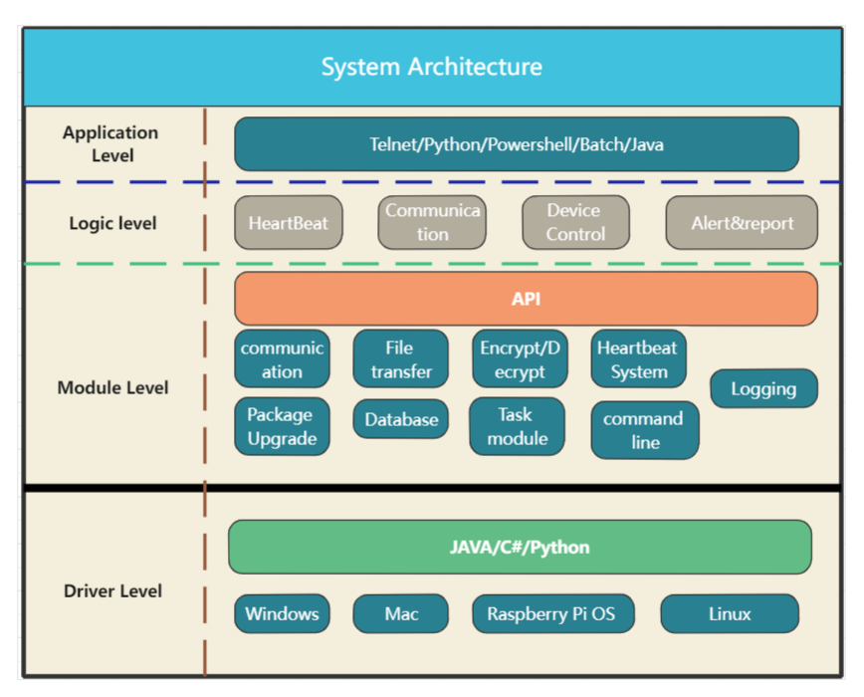
TestClient

Slide 4















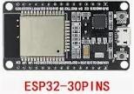
TestClient(soon.jar)
Vmware/Esxi/VitualBox
SSH
RMM Ransomware Detection/Remote Deployment/, RMM server/client, ES server/Client
RestAPI
Python/Powershell/batch/shell/AutoIT/AppleScript/Dotnet/Curl/Java/AWS CLI..
TestClient (soonr.jar)
CLI
GraphQL
ClientAPI
Workplace Server/Client: dwp/dfp/dwc/Android/iOS, RFS client
Jenkins/Gitlab/ Automaction Server...
WebAPI
RestAPI
Integration
Selenium/Appium/WinApp Driver/GRPC
Win/Mac/Linux
Web UI

Slide 5
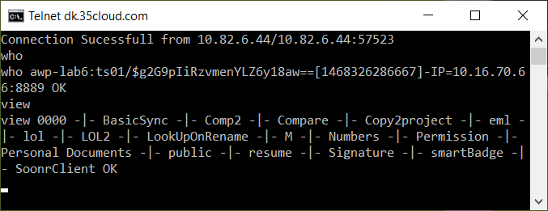
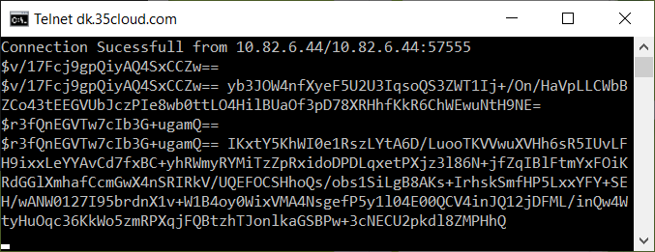
Security ? Yes -regular message -encrypt message

Slide 6
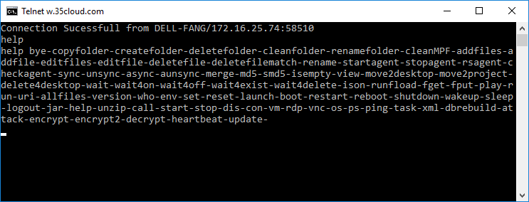
Command line inside soonr.jar
md5,smd5,upload,download..
sync,unsync, async, aunsync
wait,wait4on,wait4off..
createfolder, addfiles...
Run shell cmd, URL,Scripts..
Run Automation...
checkagent,stop/start agent...
reset,resetvfs,task,heartbeat...
encrypt, decrypt, attack,CV...
P2P Files transfer between machines..
help command [ new ☺]...
....more command....

Slide 7
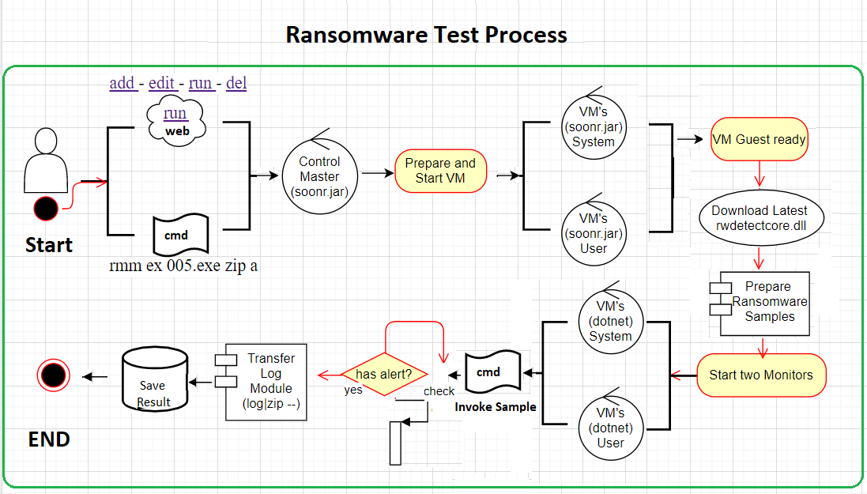
Ransomware Test Process Diagram

Slide 8
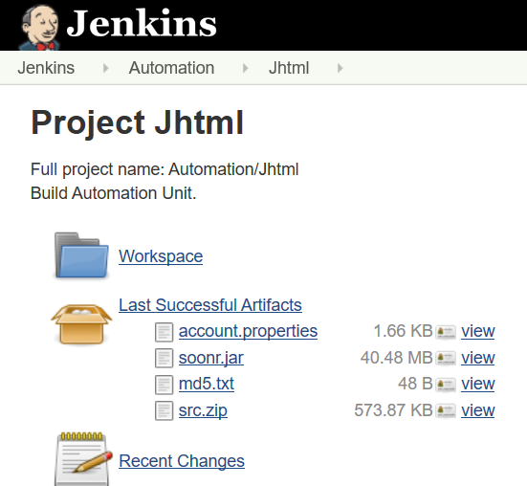
Life Cycle of Soonr.jar
Build soonr.jar
via Jenkins
Push new version to remote machine
Via p2p file transfer
Soonr.jar Auto Update
Via task 1 0 jar update

Slide 9
Deploy Automation Unit[soonr.jar]
Soonr Automation Project, Jhtml [git clone https://git.soonr.com/r/qa/jhtml]
What is it contians inside Jhtml
Automation Part
Agent remote deployment automation via AEM installation script
PSA integration + webAPI+ Backup + webUI[ Fang’s and Gabo]
Sync core automation
Operation Part
File System operation, fx: add files/folders, encrypt & decrypt,c\
Upload, Download Files/Folder. Content compare between agent and server
Multi Job runner for JUnit testing.
HeartBeat System.

Slide 10
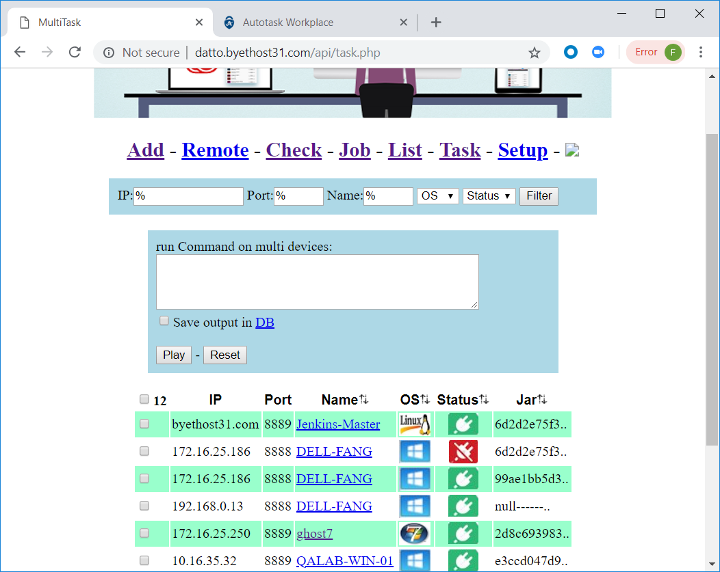
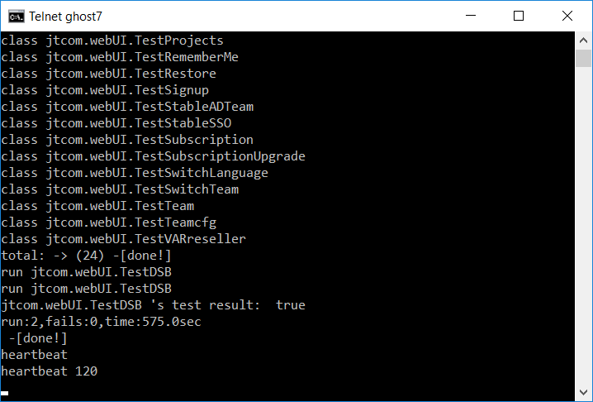
Automatio Unit[Jhtml]
Java –jar soonr.jar – to launch automation instance
Run automation via
Telnet Terminal command line
Web Portal
Heartbeat command
Heartbeat web server to collect automation resource.

Slide 11
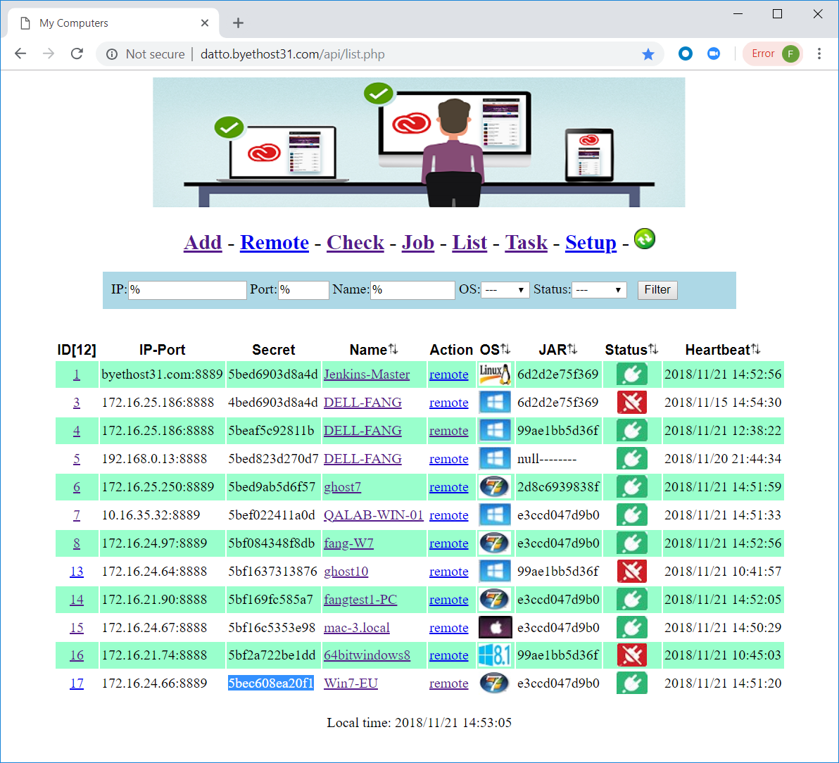
Register Autoamtion Unit
Parameters to heartbeat Server
heartbeat= 120
api=http://dk.35cloud.com/api
secret= 5bec608ea20f1
List of automation UI
Fake machine: Jenkins Master
Machine from DK office
Machine from SK office
Machine from any place

Slide 12
2 Type of Task
Private Job
Automatio Unit will ask the server in every certain periods to get private job
Public Job
If there is no private job for him, He will look for public job, which defines by one fake machines.

Slide 13
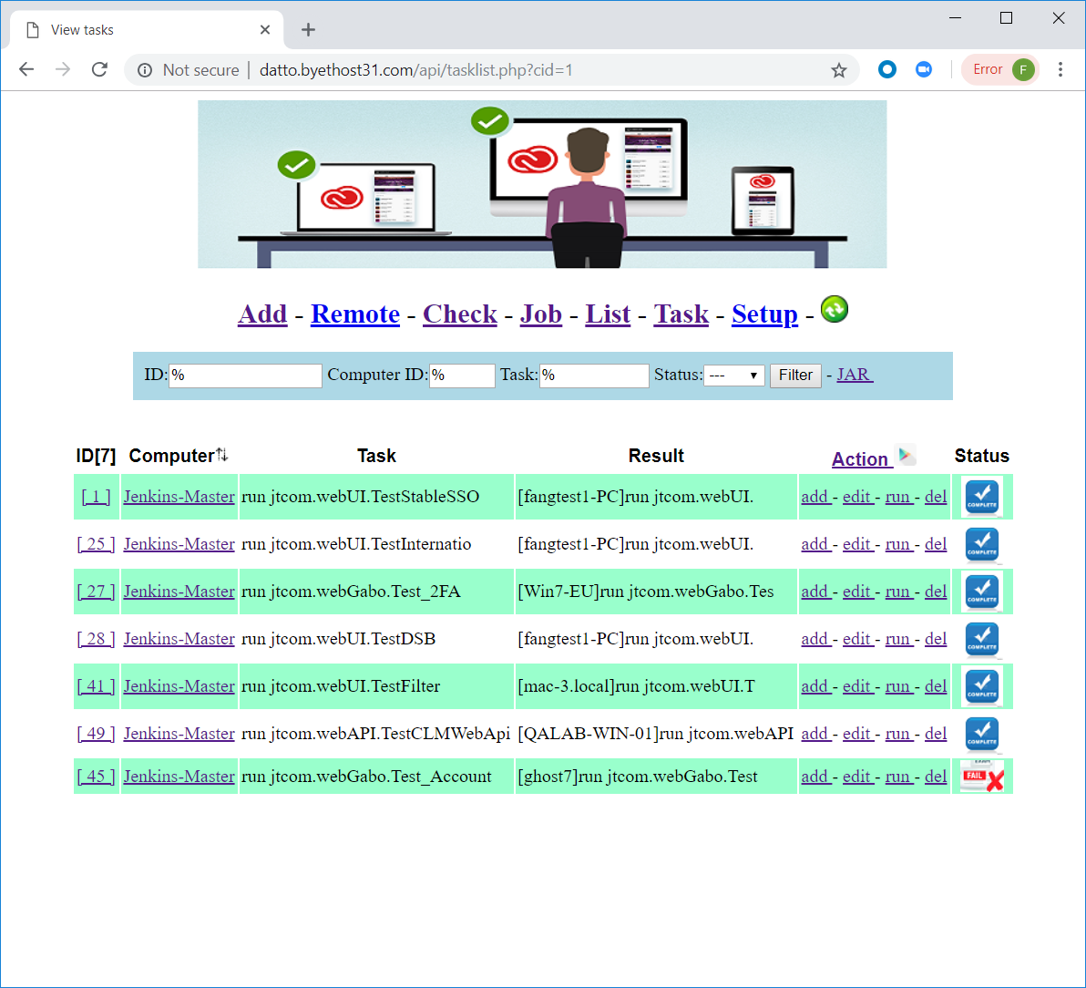
HeartBeat Server
Task exection

Slide 14
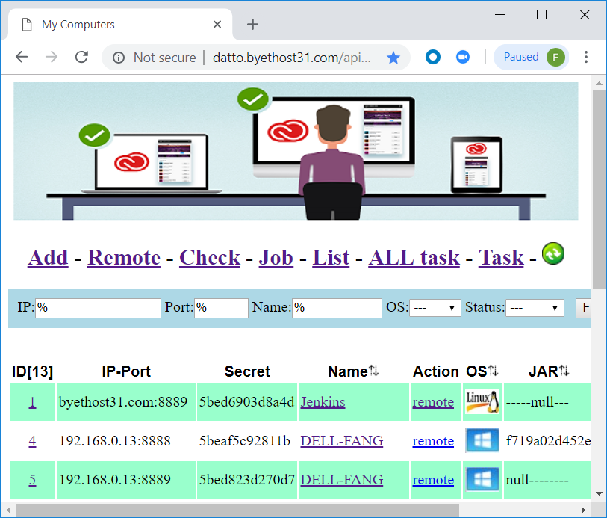
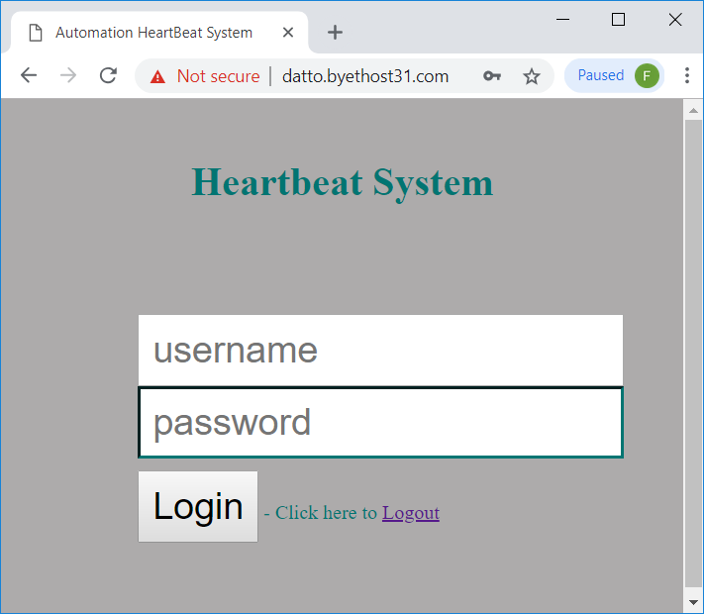
Security of HeartBeat?

